Slide 1

DEPARTMENT OF ARTIFICIAL INTELLIGENCE AND DATA SCIENCE ACADEMIC YEAR 2025 - 2026 SEMESTER III ARTIFICIAL INTELLIGENCE LABORATORY MINI PROJECT REVIEW <TITLE OF THE PROJECT>
REGISTER NUMBER
NAME | VishnuVardhan A
YEAR | II
SECTION | F
FACULTY IN-CHARGE | Mrs. M. Divya

Slide 2
PROBLEM STATEMENT
Accurately diagnosing diseases based on patient symptoms is a challenging task due to overlapping symptoms, incomplete information, and inherent uncertainty in clinical data. Manual diagnosis processes are often time-consuming, subjective, and prone to errors, especially when dealing with rare or complex diseases. This project aims to develop a Probabilistic Disease Diagnosis System using Bayesian reasoning that takes patient symptoms as input and calculates the likelihoods of multiple possible diseases from a comprehensive and structured dataset.
The system leverages probabilistic inference to quantify the uncertainty in diagnosis and present interpretable results that assist healthcare professionals in their decision-making process. By integrating statistical reasoning with medical datasets, the model aims to reduce diagnostic errors, improve efficiency, and support evidence-based medical practices. Furthermore, the system will offer a transparent diagnostic framework that can adapt and learn as more data becomes available, thus enhancing its reliability and accuracy over time.

Slide 3
THEORETICAL BACKGROUND
Theoretical Background
Disease diagnosis involves uncertainty due to overlapping symptoms and incomplete data.
Probabilistic reasoning helps manage this uncertainty.
Bayes’ theorem updates disease likelihood based on observed symptoms.
Bayesian reasoning combines prior knowledge (disease prevalence) with likelihoods for transparent and interpretable diagnosis.
Literature Survey
AI methods used: Decision Trees, SVMs, Neural Networks, Bayesian Networks.
Bayesian Networks effectively model uncertainty and causal relationships in medical data.
Naive Bayes classifiers give good performance in small or noisy datasets.
Advanced Bayesian models integrate data from multiple sources and expert knowledge.
Justification for Using Bayesian Theorem
Interpretability: Clear probabilistic results aiding clinical understanding.
Uncertainty Handling: Reliable reasoning even with incomplete data.
Data Efficiency: Works well with limited labeled data; adaptable with new inputs.
Modularity: Easily incorporates expert knowledge and complex relationships.

Slide 4
IMPLEMENTATION AND CODE
Link to code in Git-hub Repository
List | Git-hub Repository Links
Implementation of Code Link | https://github.com/VishnuVardhanAtech/Aiminiprj
Word Document Report Link | https://github.com/VishnuVardhanAtech/Aiminiprj
PPT Link | https://github.com/VishnuVardhanAtech/Aiminiprj

Slide 5
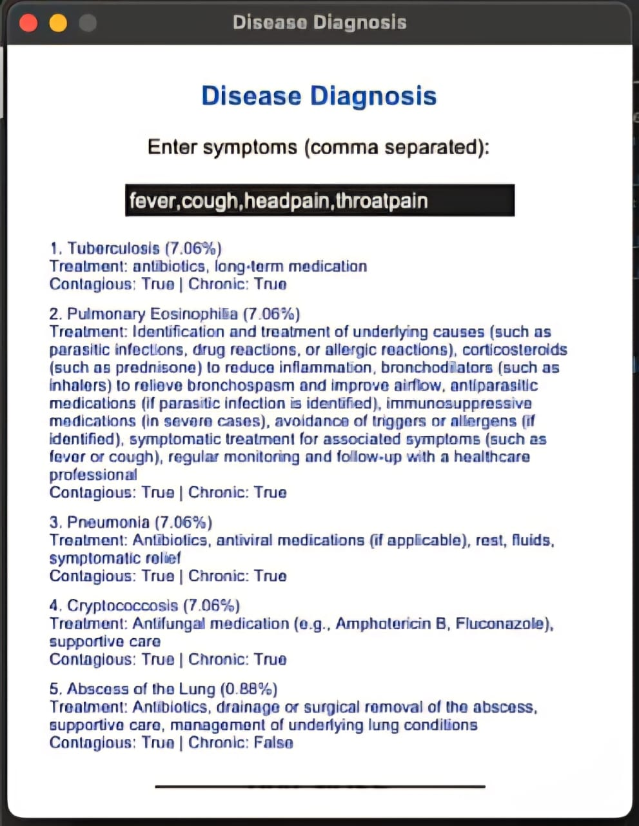
OUTPUT AND RESULTS

Slide 6
OUTPUT AND RESULTS
The output of this Bayesian disease diagnosis system shows the top five most likely diseases based on the symptoms entered by the user. For each disease, the system calculates a posterior probability that quantifies how likely the disease is given the observed symptoms. These diseases are then ranked from the highest to the lowest probability.
Along with the disease names, the system provides helpful clinical details such as recommended treatments, and indicators whether the disease is contagious or chronic. This additional information helps users and healthcare providers understand the potential impact and management of each possible diagnosis.
The probabilistic results capture the uncertainty in medical diagnosis and the overlap of symptoms across diseases. When several diseases have close probabilities, it signals that further clinical tests or evaluations may be necessary. These transparent, data-driven results enable more informed and confident decision-making, ultimately improving diagnostic accuracy and patient care.
Results:
The Bayesian disease diagnosis system effectively predicts the top 5 probable diseases based on user-input symptoms by calculating posterior probabilities. It transparently handles symptom overlap and diagnostic uncertainty, providing clear and interpretable outputs including treatment recommendations, contagiousness, and chronic disease indicators. The system offers competitive, data-driven suggestions that aid clinical decision-making..

Slide 7
REFERENCES
Bayesian Biostatistics and Diagnostic Medicine Author: Lyle D. Broemeling Publisher: CRC Press, 2007 Overview: Introduction to Bayesian methods in diagnostic medicine, including applications, models, and case studies.
Bayesian Disease Mapping: Hierarchical Modeling in Spatial Epidemiology (Third Edition) Author: Andrew B. Lawson Publisher: Chapman & Hall/CRC Interdisciplinary Statistics, 2021 Overview: Comprehensive coverage of Bayesian hierarchical models applied to disease mapping and epidemiology.
Medical Diagnosis System: Based on Bayesian Decision Theory Author: Unknown (Look for similar titled works) Overview: Focus on applying Bayesian decision theory to improve clinical diagnostic accuracy.
Bayesian Data Analysis Authors: Andrew Gelman, John B. Carlin, Hal S. Stern, David B. Dunson, Aki Vehtari, Donald B. Rubin Publisher: Chapman & Hall/CRC, 2013 Overview: Fundamental text on Bayesian inference methods, useful for understanding probabilistic modeling in medical diagnostics.
Bayesian Networks: With Examples in R Authors: Marco Scutari, Jean-Baptiste Denis Publisher: CRC Press, 2021 Overview: Practical guide to Bayesian networks, which are more advanced probabilistic graphical models relevant to disease diagnosis.

